Slide 1
PsLove dataset analyzation
Winter Coders

Slide 2
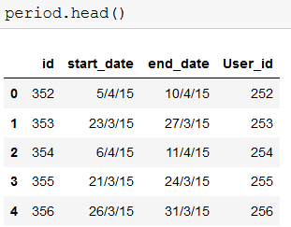


➔ Given Data
1) User Data(id,cycle_length_initial,period_length_initial) 2) Period() 3) Symptoms

Slide 3
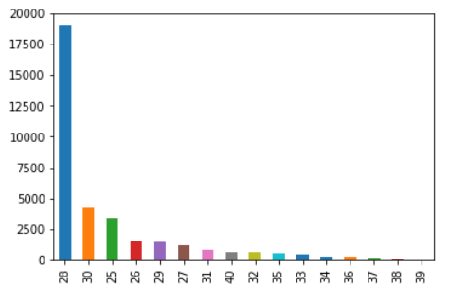
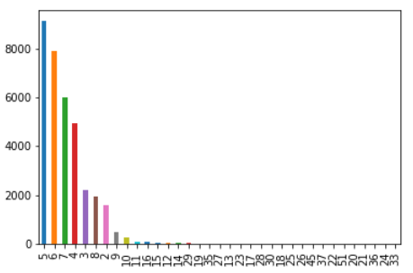
Plots
Excepted Cycle Length Initial ➔ Excepted Period Length Initial

Slide 4
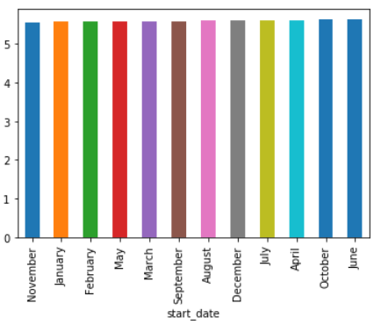
Plots
Monthly period lengths

Slide 5
Calculations
Total_count =
(Average_cycle_length) – ((“End_date” of the period) - (“Start_date” of the Period))
Expected_date =
(End_date)+(Total_count)
*Expected next Period Date will be predicted Like this*

Slide 6

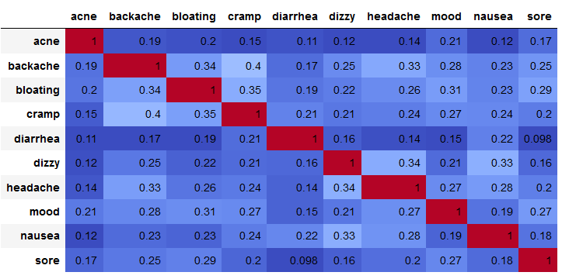
Most common occurring Symptoms
Dimentionality Reduction (PCA)
Correlation On Symptoms

Slide 7
symptoms
Based on Correlation matrix and pca
highly correlated columns are: "backache ,bloating,dizzy"

